Slide 1
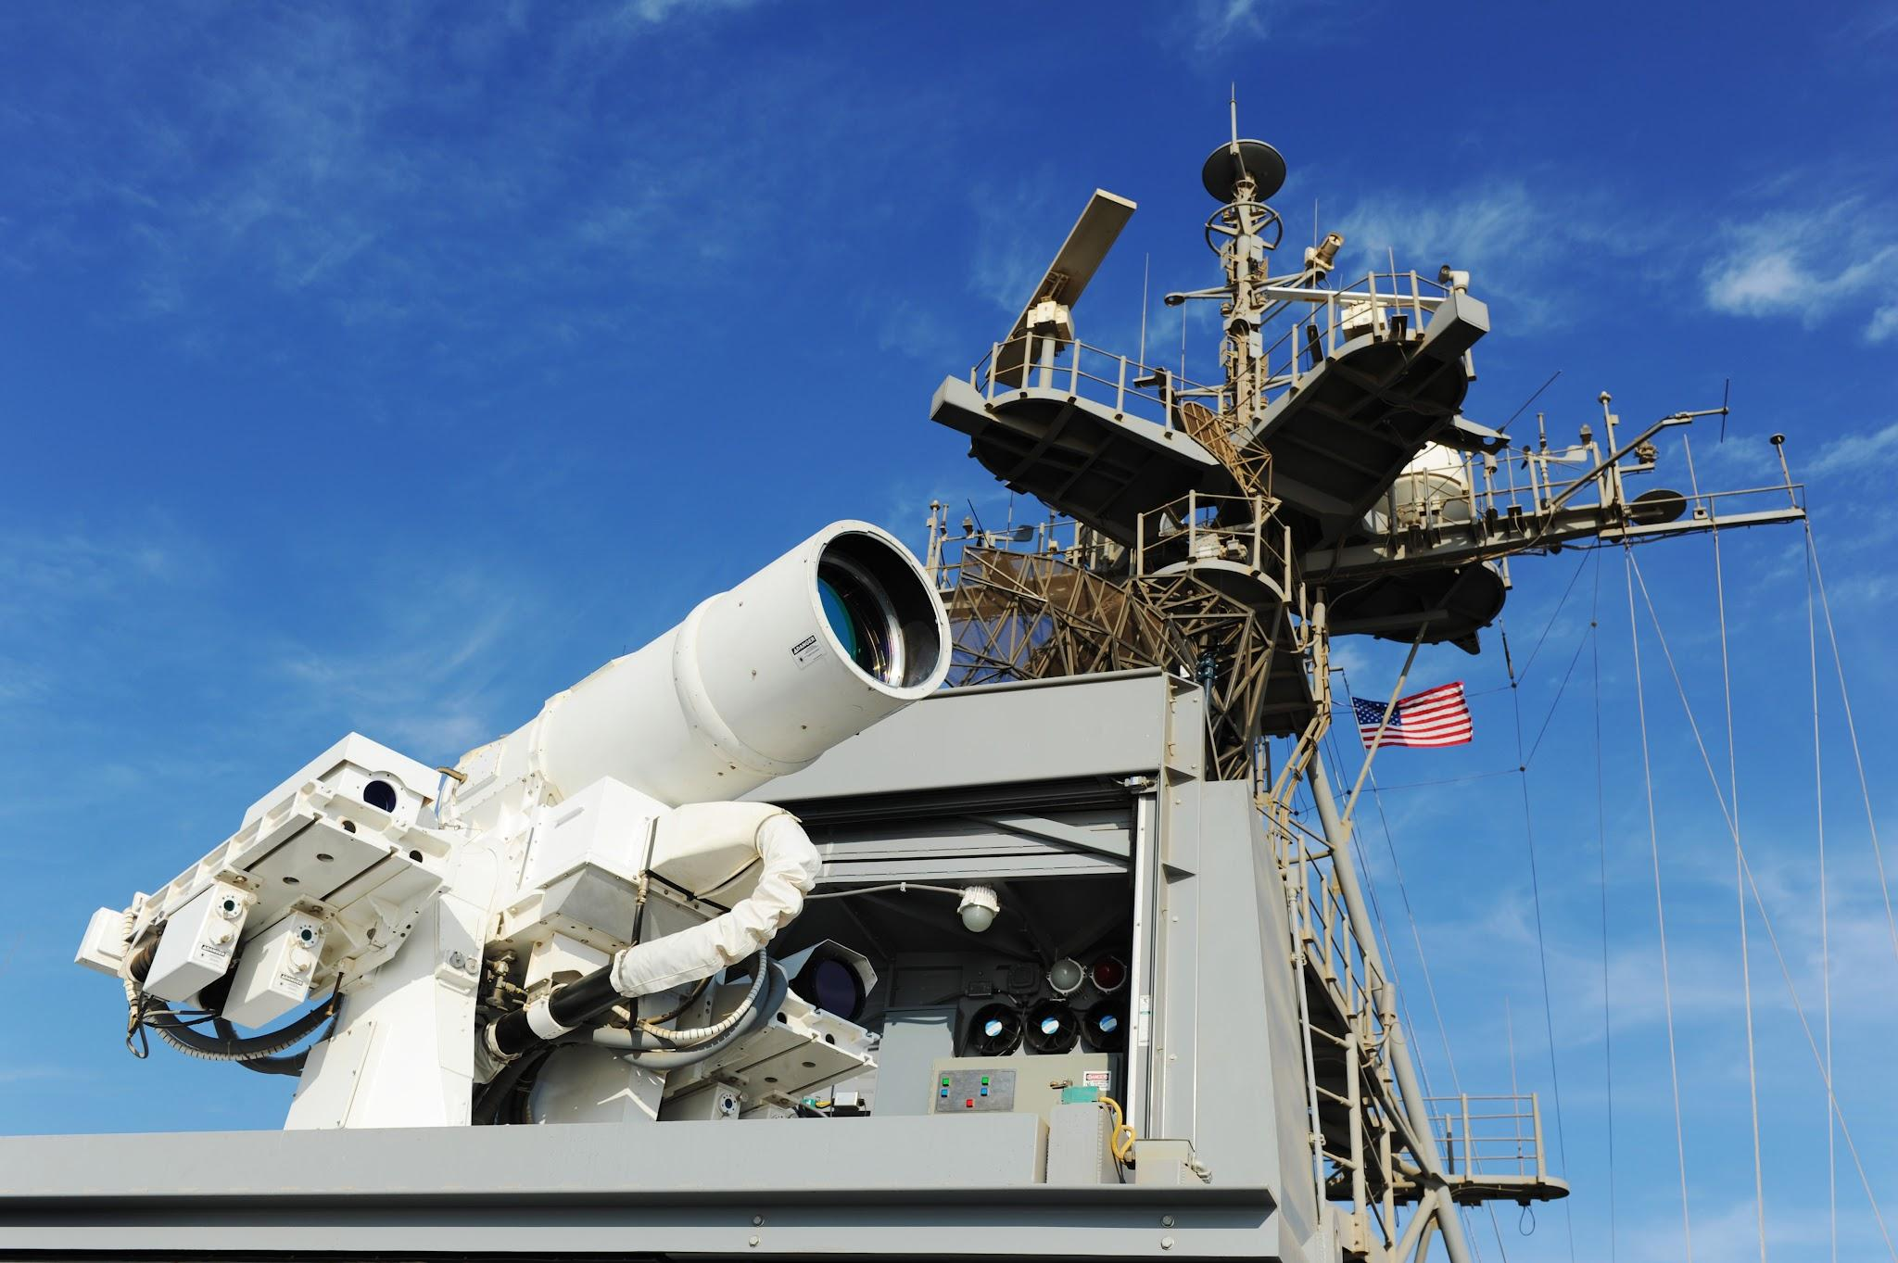
Laser Weapons: Unleashing Light’s power
Navigating the Future of Directed Energy

Slide 2
Overview
Slide 1: Laser Weapons: Unleashing Light’s power
Slide 2: Overview
Slide 3: History of Laser Weapons
Slide 4: Origins of Laser Weapons
Slide 5: The Plan and Implementation
Slide 6: Images of lasers being used in the Military
Slide 7: Upsides/Pros to the Advancements
Slide 8: Downsides/Cons to the Advancements
Slide 9: Summary
Slide 10: References

Slide 3
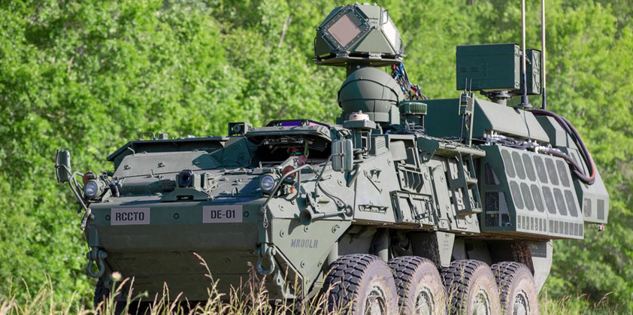
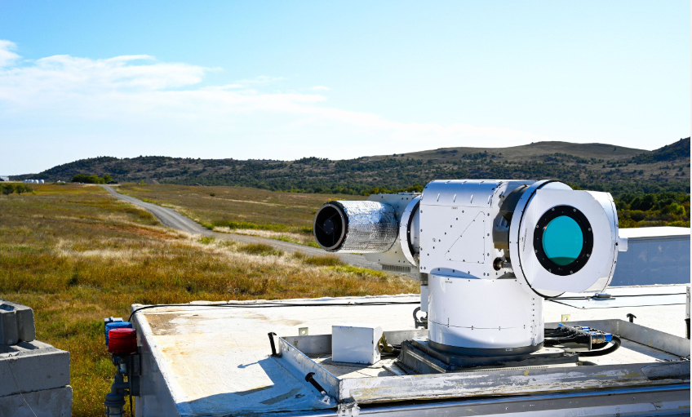
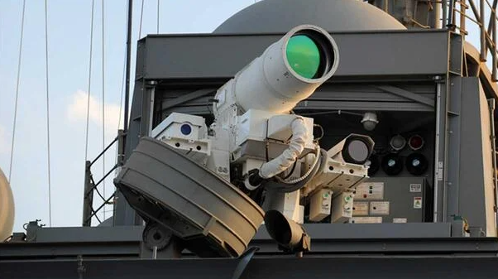
History of Laser Weapons
Next Slide for the evaluation

Slide 4
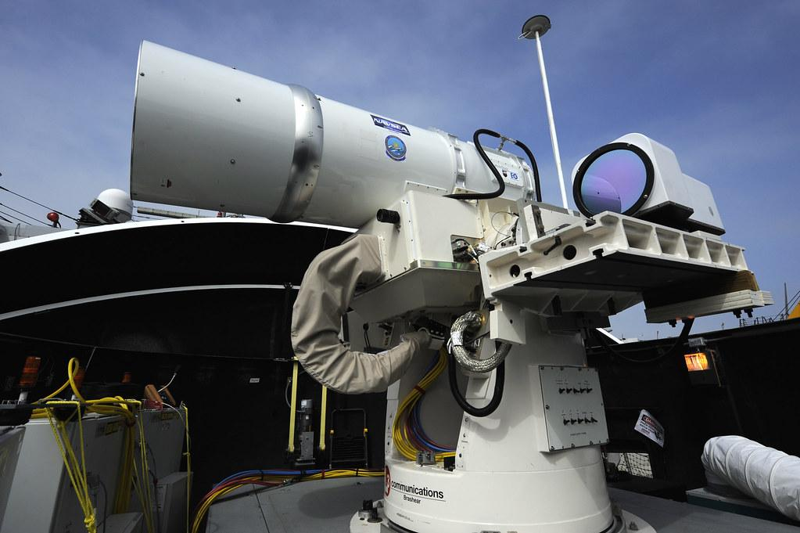
Origins of Laser Weapons
Early Laser Development (Nineteen Fifties - Sixties):
Theodore Maiman's advent of the primary functional laser in 1960.
Military Interest and Research (Nineteen Sixties - 1970s):
Strategic Defense Initiative (SDI) in 1983, highlighting U.S. Hobby in laser-based missile defense.
Advancements in laser era for ability use as directed energy guns.
Testing and demonstrations carried out through governments and protection contractors.
Involvement of essential protection contractors like Northrop Grumman, Lockheed Martin, and Raytheon.
Ongoing research and improvements in strong-nation, fiber, and chemical lasers.
Instances of laser guns being tested or deployed in navy conflicts.
Notes:
Laser guns are available in numerous sorts, every with distinct traits and packages. Lasers employ strong crystalline materials, which incorporates neodymium-doped yttrium aluminum garnet, providing sturdy and non-prevent beams. Fiber lasers use optical fibers as benefit media, providing excessive energy and performance. Chemical lasers, relying on chemical reactions for strength, had been extremely good in early laser weapon studies. This diversity allows for tailor-made solutions, adapting laser technology to precise army desires and scenarios

Slide 5
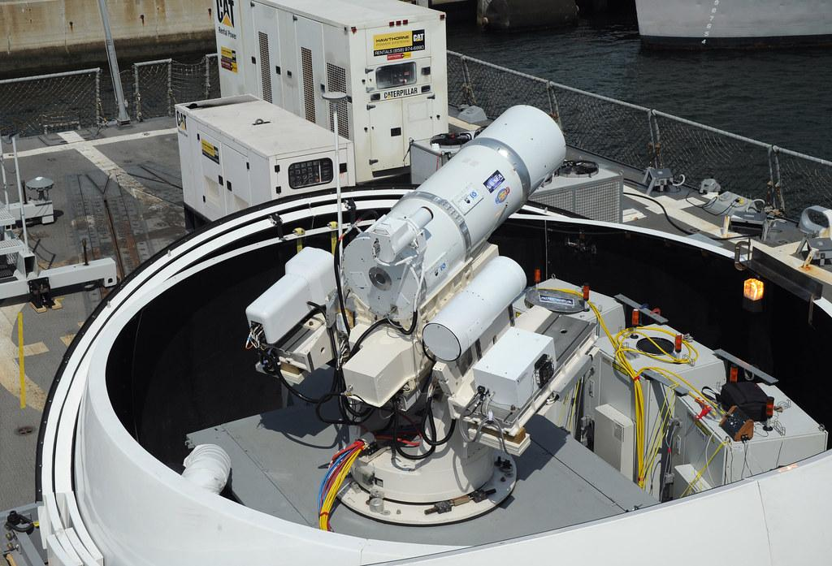
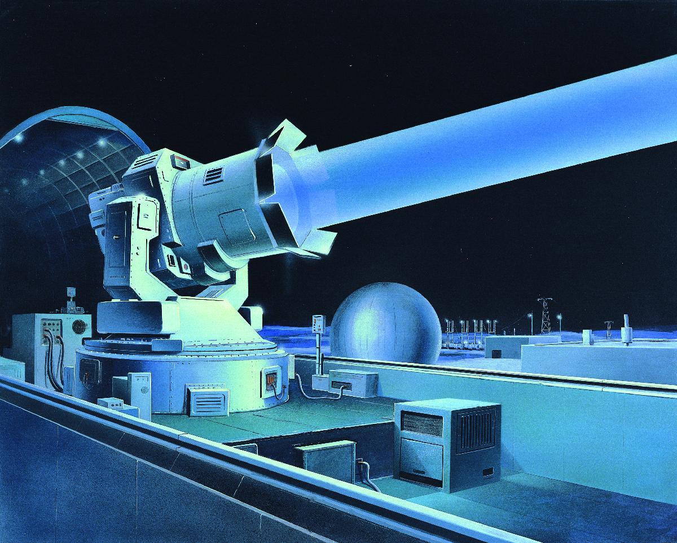
The Plan and Implementation
Types of Laser Weapons:
Solid-State Lasers: Explanation of strong-state lasers and their various programs, inclusive of precision focused on.
Overview of fiber lasers and their effectiveness in directed strength packages.
Discussion on chemical lasers and their ancient use in protection systems.
Explanation of the way laser guns allow precise concentrated on, minimizing collateral damage.
Implementation of lasers for defense towards incoming missiles.
Impact on unmanned aerial automobiles (UAVs) thru laser-based countermeasures.
Naval Deployment: Implementation of laser guns on naval platforms for maritime defense.
Airborne Systems: Consideration of laser guns included into aircraft for flexible packages.
Notes:
The implementation of laser guns in navy settings brings approximately progressive changes. Precision actions are a primary software, wherein laser beams can as it should be purpose and disable enemy assets with minimum collateral damage. Laser guns are also hired in anti-missile protection, intercepting and neutralizing incoming missiles. Furthermore, they play a vital position in countering drones and unmanned aerial cars (UAVs), providing rapid reaction talents in the direction of those evolving threats. The adaptability of laser guns for the duration of a couple of navy eventualities complements their strategic price

Slide 6
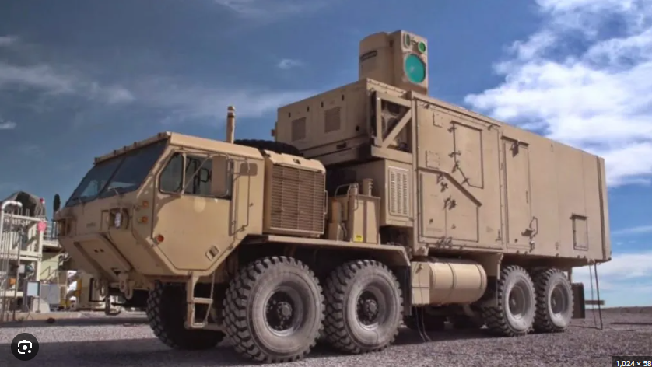

Images of lasers being used in the Military
The military hope the lasers will help prevent missles and terroist planes from attacking

Slide 7

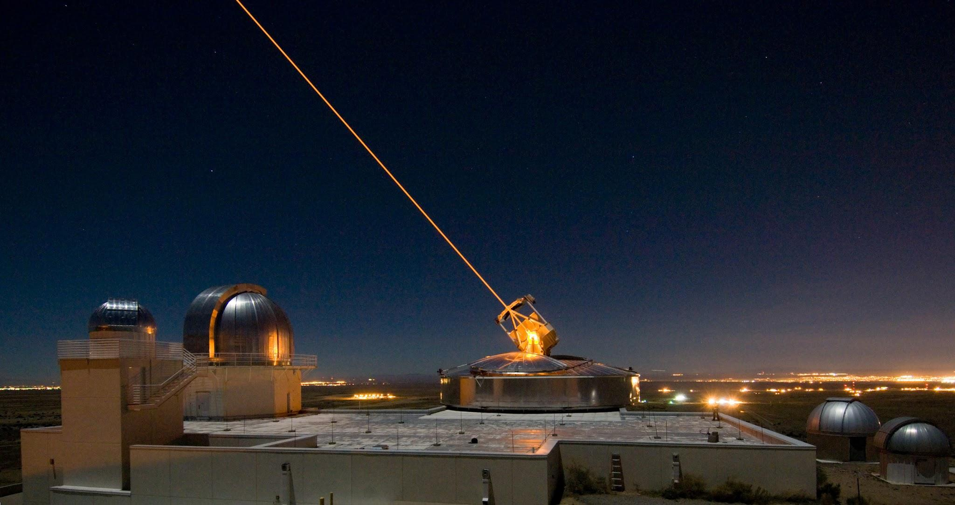
Upsides/Pros to the Advancements
Laser weapons provide unheard of precision, allowing for correct targeted on of particular gadgets or threats.
Reduced Collateral Damage: The pinpoint accuracy of laser beams minimizes the risk of unintentional damage to close by systems or civilians.
Instantaneous Target Engagement: The tempo of mild lets in close to-right now engagement with goals, providing a fast response to rising threats.
Laser guns provide faster response times in comparison to conventional weapons, improving the navy's capability to respond right away.
Laser weapons may be extra price-effective over the long time, as they don't require traditional ammunition and feature decrease protection dreams.
Compared to conventional weaponry, laser structures may be extra environmentally sustainable, decreasing useful resource consumption.
Laser weapons can serve a couple of functions, from precision actions to defense in opposition to missiles and drones.
Laser weapons can supplement conventional army competencies, imparting an extra layer of protection and offense.
The introduction of laser guns can modify strategic problems, probably reshaping navy doctrines.
Notes:
The integration of laser weapons into several protection structures is a pivotal issue in their deployment. Naval structures utilize laser guns for maritime protection, supplying a further layer of safety in opposition to threats. Airborne systems, collectively with plane, leverage lasers for flexible applications, beginning from precision movements to safety in opposition to aerial threats. Ground-primarily based definitely really laser systems make contributions to each offensive and protecting techniques, showcasing the adaptability of laser technology throughout several navy domain names. This integration marks a paradigm shift in present day-day war, improving the capabilities of traditional protection structures.

Slide 8

Downsides/Cons to the Advancements
Laser guns demand huge power to generate and preserve coherent beams, potentially foremost to immoderate strength intake.
Transporting and presenting the crucial power resources may additionally pose logistical demanding situations, mainly in faraway or opposed environments.
Laser beams may be stricken by unfavorable weather situations, together with rain, fog, or dust, restricting their effectiveness.
Atmospheric absorption and scattering can also moreover impose limitations at the effective style of laser guns.
The development and deployment of laser weapons by way of the use of multiple global locations should make contributions to an hands race, raising worries approximately worldwide balance.
Some components utilized in laser structures, in conjunction with certain types of crystals or chemical compounds, may pose environmental or health dangers.
Proper disposal of components with probably risky substances turns into a hassle for lengthy-term environmental effect.
Laser weapon structures associated with networks can be susceptible to cyber threats, risking unauthorized get proper of entry to or manipulation.
Adversaries can also extend countermeasures, which includes anti-laser generation or reflective substances, to mitigate the effectiveness of laser guns.

Slide 9
Summary
Key Takeaways:
Laser guns constitute a transformative shift in navy generation, presenting precision, tempo, and flexibility.
Advancements in laser generation have brought approximately numerous applications, from precision strikes to safety within the course of incoming threats.
While laser weapons provide numerous blessings, which incorporates decreased collateral harm and rate-standard overall performance, there are wonderful demanding situations to cope with.
The deployment of laser guns has the capability to reshape global military dynamics, introducing new problems for protection strategies and global family human beings.

Slide 10
References
Military Lasers High and Low | Air & Space Forces Magazine
How Are Lasers Being Used in the Defense Industry? | TYKMA Electrox
Military Applications of Lasers | Encyclopedia.com
A Guide to Laser Technology - NSTXL
High-energy laser weapons move quickly from prototype to deployment | Military Aerospace
Applications of Laser Technology in the Army
Directed Energy: The Focus on Laser Weapons Intensifies | RAND

